Slide 1
CHANNELS.BIZ
01
Channels.biz
Your personal or business app
AI, Web3 and blockchain technology.
The $MCC MyCityChannels ecosystem.
Platform overview / November 2026
Notes:
Updated platform overview, November 2, 2026. Owner-provided app campaign direction. Public overview: https://channels.biz/ and https://channels.biz/membership/.

Slide 2
CHANNELS.BIZ
02
Web3 and blockchain technology
AI tools connected to a Web3 ecosystem
Web3
Digital ownership and community participation sit at the center of the Channels.biz mission.
Blockchain
A shared ledger records cryptocurrency transfers and allows transaction verification.
Digital business
Channels connect local commerce and content with the broader $MCC ecosystem.
Notes:
Platform positioning: https://channels.biz/about/ (reviewed November 2, 2026). Blockchain explanation is general background. This overview does not independently verify that every platform feature or content item operates on-chain.

Slide 3
CHANNELS.BIZ
03
$MCC MyCityChannels token
The ecosystem’s cryptocurrency
Token identity
$MCC means MyCityChannels, the crypto token associated with the Channels.biz ecosystem.
Blockchain network
The official MCC Tokens Channel identifies Binance Smart Chain (BSC) as its network.
Ecosystem purpose
Platform materials describe a role in transactions, rewards and premium features.
Notes:
Sources: https://channels.biz/mcc-tokens-channel/ and https://channels.biz/about/. Public project descriptions reviewed November 2, 2026. No current market price, liquidity, staking yield or guaranteed return is represented. Contract addresses differ across older pages and are intentionally omitted pending confirmation.

Slide 4
CHANNELS.BIZ
04
Cryptocurrency and site tokens
Two balances with different purposes
$MCC cryptocurrency
A blockchain token held and transferred through a compatible crypto wallet.
Channels.biz site tokens
A separate account balance for supported features within the website.
Separate balances. No automatic one-to-one conversion.
Notes:
The official project page explicitly distinguishes MCC crypto tokens from Channels.biz site tokens: https://channels.biz/back-the-project-contribute-receive-tokens/. Also see https://channels.biz/mcc-tokens-channel/. No current purchase price or conversion promise is included.

Slide 5
CHANNELS.BIZ
05
Local discovery starts with a need
A customer has a request.
A local business has an answer.
Channels.biz gives people a place to describe what they need and helps connect them with relevant Agent Networks.
Food. Home help. Beauty. Entertainment.
Notes:
https://channels.biz/ask-bot/ (reviewed November 2, 2026).

Slide 6
CHANNELS.BIZ
06
A personal or business app
One place to share your presence
Personal
A shareable home for your interests, content and community.
Business
A place to present your products, services and customer information.
On your phone
Supported pages can install to the home screen as web apps.
Notes:
Owner-provided personal/business app and per-page PWA project context. https://channels.biz/membership/.

Slide 7
CHANNELS.BIZ
07
Ask B.O.T.
Tell B.O.T. what you need
Describe the request
Include the service, location and timing that matter.
Find the right network
B.O.T. helps route the request to an existing Agent Network.
Choose your next step
Review available provider responses and decide what works for you.
Notes:
https://channels.biz/ask-bot/. Request-and-offer behavior from owner project context. Provider eligibility and availability vary.

Slide 8
CHANNELS.BIZ
08
Agent Networks
Business presence with local context
Choose an Agent Line
Connect your business to the appropriate city or service network.
Define your service area
Keep your products, services and ZIP coverage accurate.
Manage opportunities
Respond to eligible customer requests through the supported workflow.
Notes:
Owner-provided Agent Line selection, ZIP coverage and claim flow context. https://channels.biz/ask-bot/.

Slide 9
CHANNELS.BIZ
09
Channels.biz and MyCityChannels.com
Connected platforms, clear destinations
Channels.biz
Personal and business apps, Ask B.O.T. and Agent Networks.
MyCityChannels.com
City discovery, community FUNraisers, Prize Vault and Best of the Best.
Milwaukee is the first city. The model is built for more cities.
Notes:
Owner-provided platform positioning and city rollout decisions. https://channels.biz/ and https://www.mycitychannels.com/.

Slide 10
CHANNELS.BIZ
10
Best of the Best
Community recognition in your city
Local businesses
Nominate and discover favorites by category.
Free voting
Sign in and cast one vote per category in each city.
Community participation
Explore the city FUNraiser and Prize Vault alongside local recognition.
Live in Milwaukee on MyCityChannels.com
Notes:
Owner-provided BOTB voting rules and November 2, 2026 migration context. Voting does not require a purchase. https://www.mycitychannels.com/fundraiser-board-game/.

Slide 11
CHANNELS.BIZ
11
Date Planner
A plan for the occasion
Set the details
Choose a market, occasion, date and budget.
Choose the services
Dining, flowers, lodging, transport, entertainment and more.
Continue with Ask B.O.T.
Review your request and look for relevant local options.
Atlanta Valentine’s Day pilot with selected test markets
Notes:
https://channels.biz/date-planner/ (reviewed November 2, 2026). Owner-provided Atlanta pilot direction. Options depend on provider coverage and availability.

Slide 12
CHANNELS.BIZ
12
Community partnerships
Local business can support local causes
Nonprofits and organizers
Build a presence and participate in eligible city programs.
Businesses and sponsors
Connect products, services and campaign support with community activity.
Seasonal campaigns
Toyz N’ Da Hood ’26 brings holiday outreach into the network.
Notes:
Owner-provided Club Kids Inc., city nonprofit participation and Toyz N’ Da Hood ’26 campaign context. https://channels.biz/christmas-toyz-n-da-hood-26-channels-biz/.

Slide 13
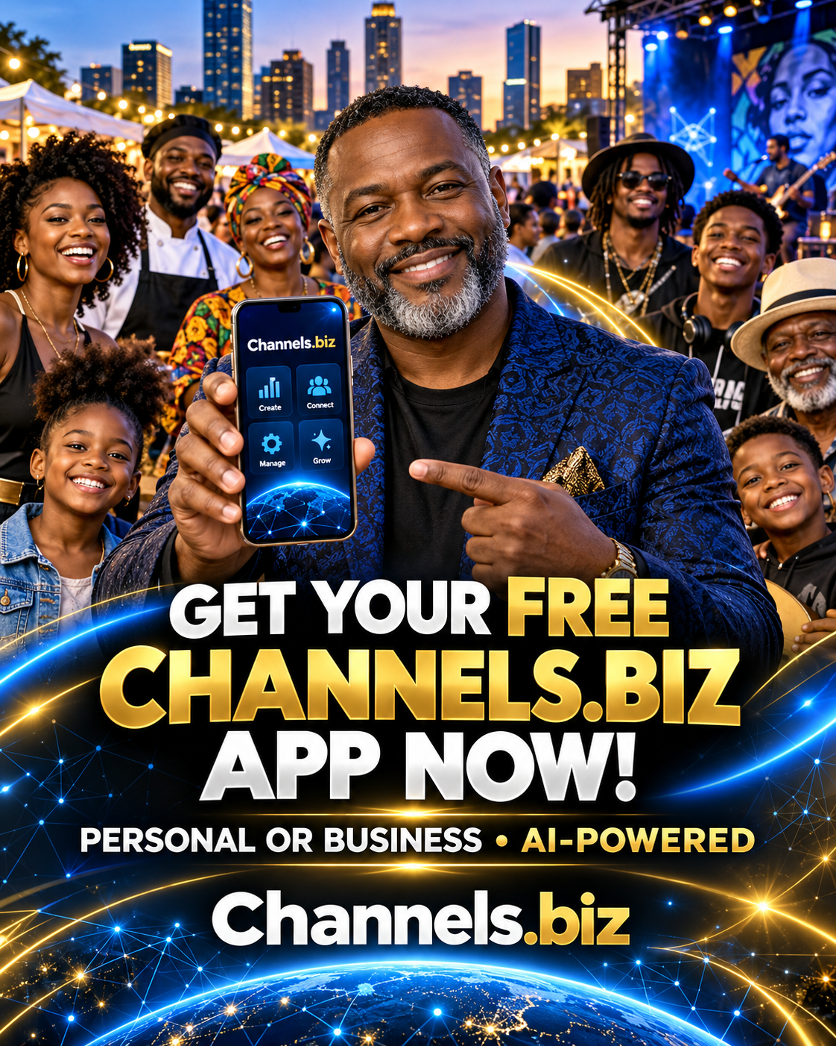
CHANNELS.BIZ
13
Your next step
Start your free Channel
Create your personal or business presence. Explore Ask B.O.T., Web3 and the $MCC MyCityChannels ecosystem.
channels.biz/membership/
channels.biz/ask-bot/
Notes:
https://channels.biz/membership/ lists free Starter enrollment. Paid Agent setup and other services are separate. No guaranteed income, leads or bookings. Promotional illustration: owner’s “Channels.biz community app celebration.png”, generated artwork, not a photograph of a real event.

